Slide 1

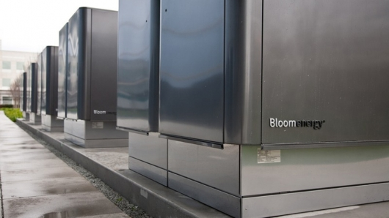

Slide 2
Solid Oxide Fuel Cells
Sustainable Energy Solutions
Mohit Bhasin, Maxwell Cheshier, Noel Manto, and Anahit Sarao
Bloom Energy Consultant Group

Slide 3

Introduction
Who are we?
What do we do ?
How can we help the city of San Jose ?

Slide 4

Background
Alternative energy, because of the rising energy.
The residential sector must seek the benefits of today’s alternative energy conversion.
Households become independant from the grid
Bloom Energy can help the City of San Jose improve its energy infrastructure with the use of fuel cells.

Slide 5

Scope of Work
The focus and purpose of our work.
Impacts and changes made in the past.
Bloom Energy and the Future
“We cannot solve our problems with the same thinking we used when we created them.”
Albert Einstein

Slide 6
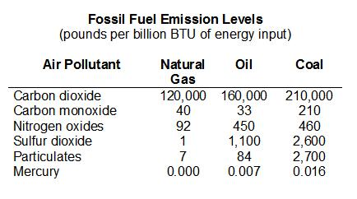
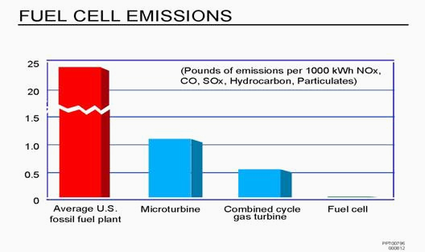
Environmental Aspects
A solid oxide fuel cell is very efficient itself as it intakes a form of fuel such as hydrogen or any biogas plus oxygen rich air to output water and carbon dioxide.
The byproduct of using fuel cells is mainly water and relative amounts of gasses.
SOFC run at high temperatures.
The byproducts can be used to power other appliances such:
Water Heaters
Air Conditioners
Stoves
Reduce appliance that rely on natural gases further reducing the overall emissions of a single residential home.

Slide 7

Technical Aspects
Power generation between 100kW to 300kW dependent on the size and power usage each of residential building.
Current architecture of Bloom Energy products can operate for 96 hours during power outages, provide a relative a max load of 50kW.
Connected in a max parallel of 5 units.

Slide 8
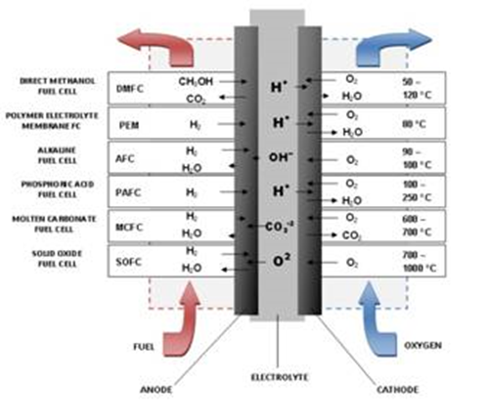
Types of Fuel Cells
1) AFC – Alkaline fuel cell
2) PEM – Proton exchange membrane fuel cell
3) DMFC – Direct methanol fuel cell
4) MCFC – Molten carbonate fuel cell
5) PAFC – phosphoric acid fuel cell
6) SOFC – Solid oxide fuel cell

Slide 9
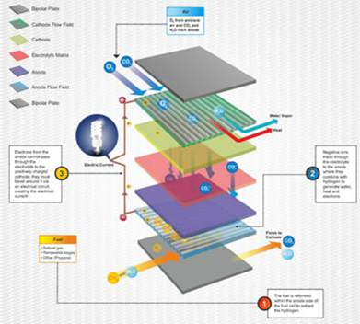
Why SOFC?
Reasons why SOFCs are fuel cell technology of choice:
- Fuel flexible
- Economical
- High temperature technology enables Cogeneration applications
- Can facilitate high levels of carbon capture

Slide 10
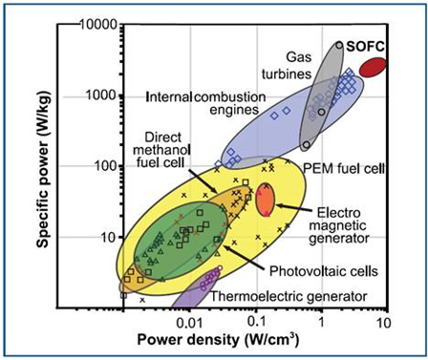
Energy Density: How Does SOFC Compare
SOFC chemical to energy delivers the highest theoretical efficiency:
- 50-60% only electricity.
- 70-90% when coupled with Co-generation applications.
SOFC has highest volumetric power density of any electricity generation technology.

Slide 11

SOFC Details
Planar SOFC holds the greatest potential of any fuel cell technology.
Two types of SOFC - planar and tubular.
Bloom Energy uses planar SOFC

Slide 12
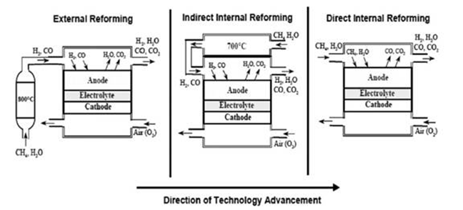
SOFC Fuel Reformer
SOFCs high temperature process can reform fuel efficiently. Fuel Reforming is the process required to convert methane (natural gas) to hydrogen and CO to be usable for chemical reaction.

Slide 13
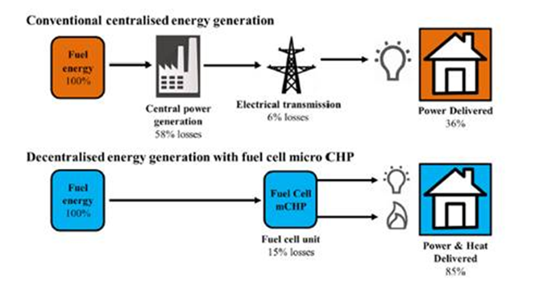
Distributed Generation
Concept of point of consumption where generating power is on-site.
Cost savings, eliminates installation complexity and the inefficiencies of ohmic losses.

Slide 14
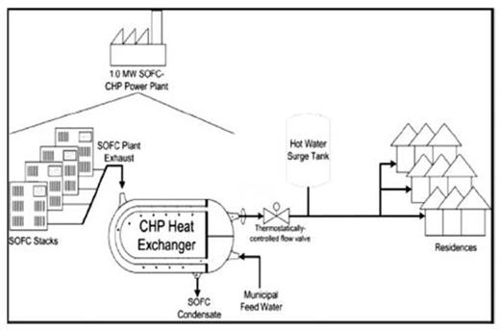
Co-generation CHP and CCHP
SOFCs has the ability to co-generate other applications:
CHP – (Combined Heat and Power) efficiency elevated up to 90%.
CCHP – (Combined Cooling, Heat and Power) also called tri-generation, can also increase efficiency, reduce CO₂ emission, and lower operational cost.

Slide 15
SOFC Application
Three main applications:
1-10KW (Residential)
Several MW (Mid to Large Commercial Plants)
25-250MW (Commercialization End)

Slide 16
Bloom Energy SOFC
SOFC are the most efficient fuel cell electricity generators
Reliability
Fuel flexibility
Distributed generation – point of use
Reduced greenhouse gas emission
High temperature systems
Small physical footprint
Small to no water usage

Slide 17
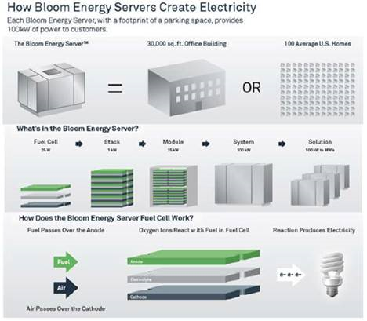
Bloom Energy Servers
Bloom Energy uses SOFC made of low cost (planar) solid ceramic square materials.
Bloom Energy servers is the reliability of clean energy 24 hours per day.
Bloom Energy server is one of the most sustainable solutions on the market today.

Slide 18
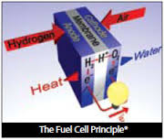
Fuel Cell Challenges
Fuel Cell Cost and Durability
Hydrogen Storage
Hydrogen Production and Delivery
Public Acceptance

Slide 19
Solar Power
Solar efficiency, like crystalline silicon, has improved to 16%.
Advantages:
Renewable
Abundant
Sustainable
Environmentally friendly
Good availability
Low maintenance
Government incentives
Disadvantages:
Initially expensive
Intermittent
Energy storage is expensive
associated with pollution
Exotic type of materials used
Footprint

Slide 20
Wind Power
Wind Power offers good alternative over traditional power.
Advantages:
Clean fuel source
Cost effective
Creates jobs
Disadvantages:
Initially expensive
Intermittent
Noise pollution
Large footprint
Issues with wildlife

Slide 21
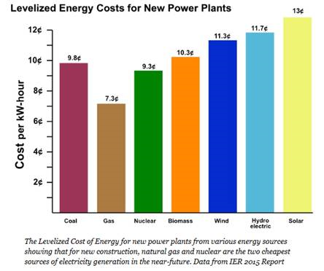
Cost Comparison
CEO and Founder K.R. Sridhar said the a Bloom Server will produce power for nine to 10 cents per kilowatt hour after incentives. This price includes service, maintenance, gas and all other costs associated with running it. Another comparison released by Forbes Business in 2015 shows that wind operates
at 11.3 cents per kilowatt hour
and solar operates at 13 cents
per kilowatt hour.
By comparison, the Bloom Server
can be operated lower than Solar
or Wind.
Notes:
Here’s an idea on how to format this slide
9-10 cents per kilowatt hour
Service, maintenance, gas, and other costs included
Wind and solar are more expensive
You can then elaborate on all of these points with what is currently on the slide

Slide 22

Project Cost
The total cost of the project should run around 3.1 million dollars, which should include the SOFC and setup of all the equipment and supplies. A part of the money will also go to run the project, which might include facilities and administrative costs.

Slide 23

Task Schedule

Slide 24
Recommendations
We at Bloom Energy believe that the implementation of solid oxide fuel cells are an alternative source of energy that would greatly benefit the city of San Jose. There are several alternatives: solar, wind, or Bloom Energy SOFC, from the list SOFC is the most efficient and least harmful.
The rising energy cost and the dependency from fossil fuel has encouraged the public in search for a potential alternative energy source. Using Bloom Energy servers to provide energy for low income homes would help the residents save money because fuel cells are highly efficient.
With this in mind, implementing fuels cells to power 150 homes will provide a great model to show the benefits of solid oxide fuel cells. Fuel cell technology is an attractive alternative because it’s clean, reliable, and becoming more affordable.
Bloom Energy generates clean, reliable power on site with minimal environmental impact, making the Bloom Energy Server one of the most sustainable solutions on the market today.

